Slide 1

DevSecOps team
SonarQube

Slide 2
Agenda
Continuous inspection
DAST vs SAST
SonarQube
How SonarQube works
Features of SonarQube
Quality Gates
Quality Profiles
SonarQube dashboard metrics
Installation of SonarQube

Slide 3
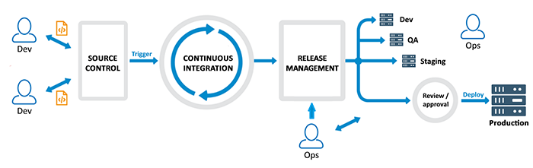
Continuous Inspection
Continuous code inspection means constantly scanning your code for defects
Code inspection improves overall code quality.
run-time errors that can cause unwanted behavior.

Slide 4
SAST & DAST
SAST | DAST
White box security testing | Black box security testing
Requires a source code | Requires a running application
Finds vulnerability earlier in the SDLC | Finds vulnerability at the end of the SDLC
Less expensive to fix vulnerability | More expensive to fix vulnerability
Runtime & environment related issues cannot be detected | Runtime & environment related issues can be detected
Typically supports all kinds of software | Typically supports only web apps and web services

Slide 5
SonarQube
SonarQube is an open-source platform developed by SonarSource for continuous inspection of code quality to perform automatic reviews with static analysis of code to detect bugs, code smells, etc.

Slide 6
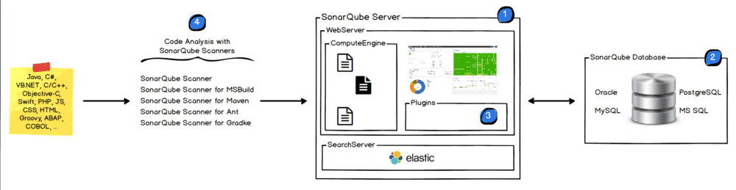
How SonarQube works?
Sonar uses various static & dynamic code analysis tools such as Checkstyle, PMD, FindBugs, FxCop, Gendarme, and many more to extract software metrics, which then can be used to improve software quality

Slide 7
SonarQube features
Supports languages: Java, C/C++, Objective-C, C#, PHP, Flex, Groovy, JavaScript, Python, PL/SQL, COBOL, etc. (note that some of them are commercial)
Can also be used in Android development.
Offers reports on duplicated code, coding standards, unit tests, code coverage, code complexity, potential bugs, comments, design, and architecture.
Records metrics history and provides evolution graphs (“time machine”) and differential views.
Provides fully automated analyses integrates with Maven, Ant, Gradle, and continuous integration tools (Atlassian Bamboo, Jenkins, Hudson, etc.).
Integrates with the Eclipse development environment
Integrates with external tools: JIRA, Mantis, LDAP, Fortify, etc
Is expandable with the use of plugins.

Slide 8
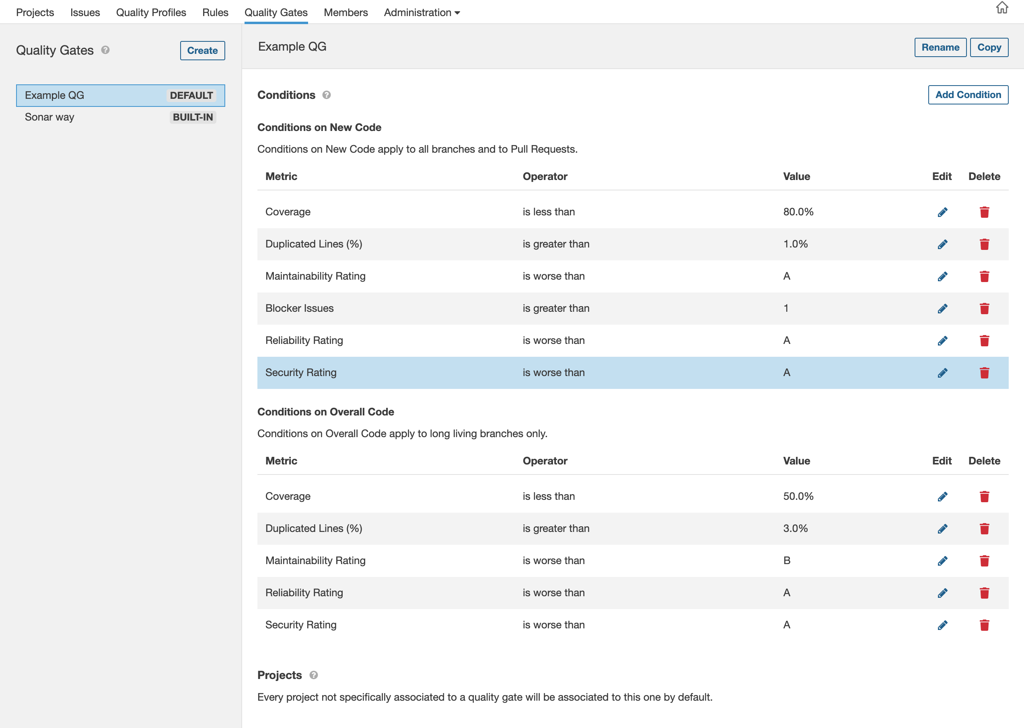
Quality Gates
Quality Gates are the set of conditions a project must meet before it should be pushed to further environments

Slide 9
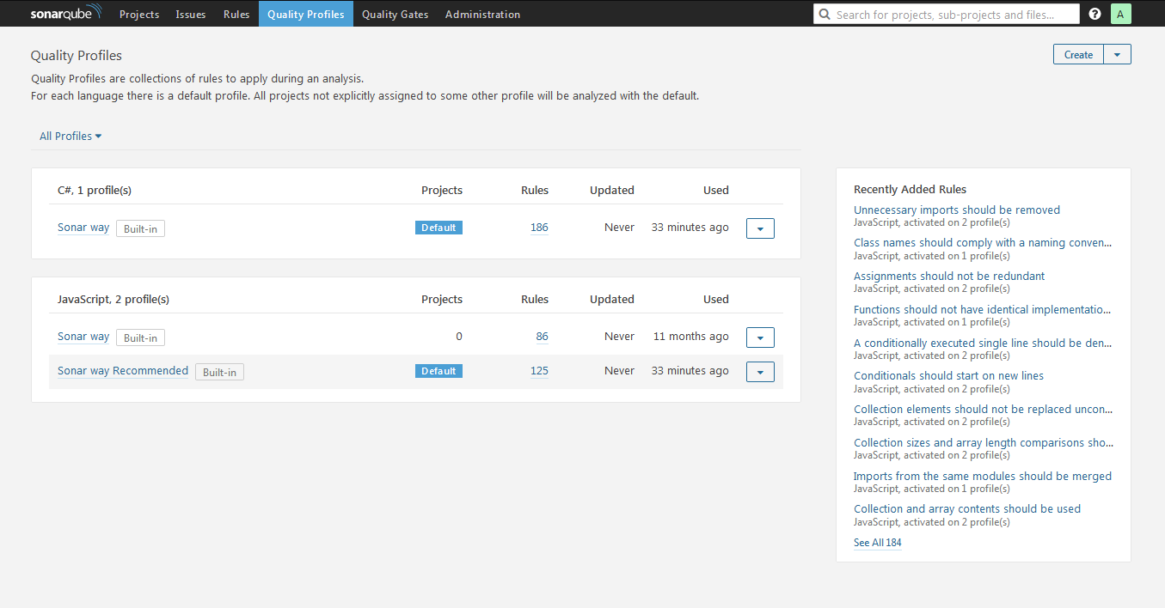
Quality Profiles
Quality Profiles are collections of rules to apply during an analysis for a particular rule.

Slide 10
SonarQube dashboard metrics
Complexity :
It is the Cyclomatic Complexity calculated based on the number of paths through the code.
Ex: Java - Keywords incrementing the complexity: if, for, while, case, catch, throw, &&, ||, ?
VB.NET - The complexity gets incremented by one for: method or constructor declaration (Sub, Function), AndAlso, Case, Continue, End, Error, Exit, If, Loop, On Error, GoTo, OrElse, Resume, Stop, Throw, Try.
Duplications
Number of duplicated blocks of lines.
Issues
New issues (new violations)
Number of issues raised for the first time on New Code.
New xxx issues (new_xxx_violations)
Number of issues of the specified severity raised for the first time on New Code, where xxx is one of: blocker, critical, major, minor, info.

Slide 11
SonarQube dashboard metrics
Maintainability:
Code Smells
Total count of Code Smell issues.
New Code Smells
Total count of Code Smell issues raised for the first time on New Code.
<=5% of the time that has already gone into the application, the rating is A
between 6 to 10% the rating is a B
between 11 to 20% the rating is a C
between 21 to 50% the rating is a D
anything over 50% is an E
Technical Debt
Effort to fix all Code Smells. The measure is stored in minutes in the database.

Slide 12
SonarQube dashboard metrics
Reliability:
Bugs
Number of bug issues.
Reliability Rating (reliability_rating)
A = 0 Bugs
B = at least 1 Minor Bug
C = at least 1 Major Bug
D = at least 1 Critical Bug
E = at least 1 Blocker Bug

Slide 13
SonarQube dashboard metrics
Security:
Vulnerabilities
Number of vulnerability issues.
Security Rating (security_rating)
A = 0 Vulnerabilities
B = at least 1 Minor Vulnerability
C = at least 1 Major Vulnerability
D = at least 1 Critical Vulnerability
E = at least 1 Blocker Vulnerability

Slide 14
SonarQube dashboard metrics
Tests:
Coverage
It is a mix of Line coverage and Condition coverage.
How much of the source code has been covered by the unit tests?
Coverage = (CT + CF + LC)/(2*B + EL)
where
CT = conditions that have been evaluated to 'true' at least once
CF = conditions that have been evaluated to 'false' at least once
LC = covered lines = linestocover - uncovered_lines
B = total number of conditions
EL = total number of executable lines (lines_to_cover)

Slide 15
Installation of SonarQube
https://www.sonarqube.org/downloads/
https://digitalavenue.dev/Install-SonarQube-On-Ubuntu-Debian/

Slide 16
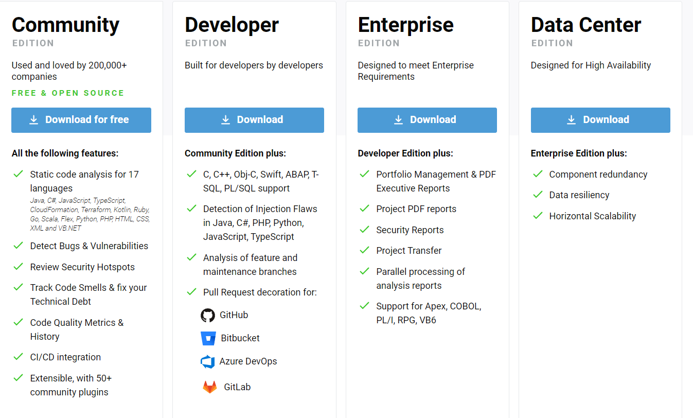
SonarQube pricing
https://www.sonarsource.com/plans-and-pricing/

